Slide 1
Sensor Descriptive Movements for Path Recording
Zheng Lu, Zhiyang Zhang, Michael Craze
Notes:
9/30/13 04:00:54 PM
1

Slide 2
Work flow

Slide 3
Sensor part
Speed of movements
Counting steps instead of calculate accelerations
Hold the phone to reduce false positives
Direction of movements
Map magnetometer readings into four directions

Slide 4
GPS part
Get the Initial coordination
We don’t use it for calibration because of short tracks in our test
We can not eliminate the initial position error during the test

Slide 5
Map part
Offline path recording
Python lack map APIs
Can use Java to implement it in an online approach

Slide 6
Challenge : Accelerometer readings
Set the parameter for different person
Step size
Step count threshold

Slide 7
Challenge : Magnetometer readings
Need Calibration on different location
Affected severely by buildings and metal obstacles

Slide 8
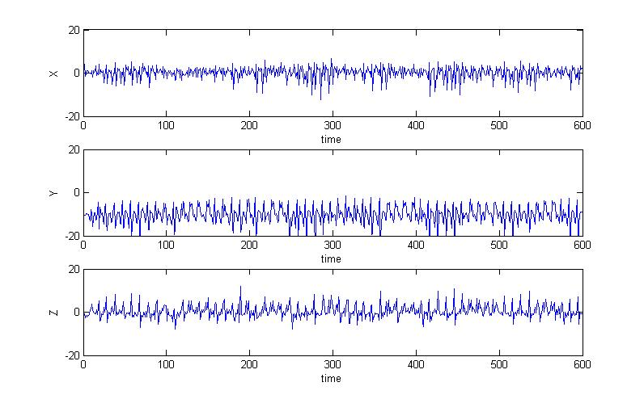
Sample Input

Slide 9
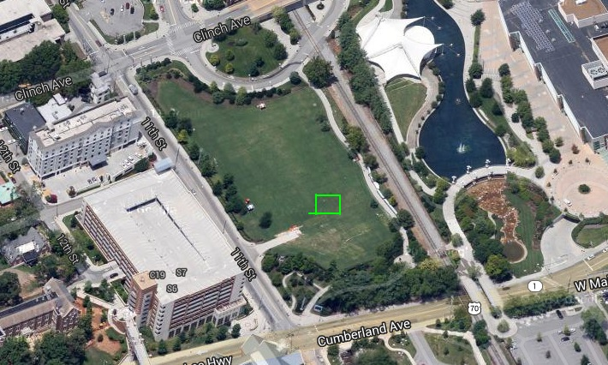
Sample result

Slide 10
Demo
http://www.youtube.com/watch?v=WqGhbJq0ehQ

